Slide 1
A Personal Retrospective:
Past Work on Sleep and Aging and the Possibilities for the Future
Katie L. Stone, Ph.D.
For:
University of Pennsylvania
K24 Lecture Series in Sleep and Aging
Michael Perlis, Principal Investigator
June 27, 2017

Slide 2
San Francisco Coordinating Center
(coordinatingcenter.ucsf.edu)
Non-profit academic research organization with ~ 30 years experience conducting multi-center studies and clinical trials
Collaborative enterprise of the UCSF Department of Epidemiology and Biostatistics and California Pacific Medical Center
Mission: to conduct high quality multi-center studies that have an impact on science, clinical practice, and public health
Diverse research interests:
  aging cardiovascular disease
  sleep and circadian genetics
  physical activity/function osteoporosis
  osteoarthritis cognitive function/dementia
  biostatistics/research methods

Slide 3
My Journey Into Sleep Research
Trained as biostatistician, then epidemiologist
  dissertation focused on diet and bone health in the elderly (SOF cohort)
Measures of subjective sleep collected, had not been analyzed
Disturbed sleep as a risk factor for falls and fractures?
  Sleep could be the “third pillar” of health, under-recognized compared to diet and physical activity
Notes:
Sonia Ancoli-Israel, Ph.D.
GC 2000

Slide 4
Van Cauter Laboratories:
Sleep Debt Study*
Subjects restricted to 4 hours sleep per 24hr period, for 6 consecutive days
Measured endocrine function before and after sleep restriction
Findings: Sleep restriction results in…
  ↓ Glucose tolerance, thyrotropin
  ↑ Evening cortisol levels
  ↑ Activity of sympathetic nervous system
* Spiegel et al, Lancet, 1999

Slide 5
Sleep Debt Study* Conclusions
Sleep debt has a harmful impact on endocrine function
Effects are similar to those seen in aging
Chronic partial sleep deprivation may increase the risk of chronic diseases including
  Obesity
  Diabetes
  Cardiovascular disease and shorter survival
  Dementia/cognitive decline
  Etcetera…
*Spiegel et al, Lancet, 1999

Slide 6
SOF and MrOS Cohorts
Large observational multi-center cohorts of community-dwelling older women (SOF) and men (MrOS)
  original aims focused on risk factors for osteoporosis, falls and fractures
  ultimately, became studies of aging in general
  at the time (circa 2000) there were few sleep epidemiology studies
Successful R01 applications to add comprehensive measures of sleep to SOF and MrOS (funded by NIA and NHLBI)

Slide 7
Background: Sleep and Aging

Slide 8
‘Normal’ Age-Related Changes in Sleep
Sleep becomes more fragmented, and shorter in total duration
Alterations in sleep architecture
  Decreased slow wave (stages 3 & 4) sleep
  Longer sleep latency
Alterations in circadian rhythms
Increased fatigue and daytime napping
Notes:
Sonia Ancoli-Israel, Ph.D.
GC 2000

Slide 9
Factors Affecting Sleep in the Elderly
“Primary” Sleep Disorders
  Insomnia
  Sleep Disordered Breathing (Sleep Apnea)
  Periodic leg movements in sleep
  Circadian rhythm disorders
Medical illness
Medications/polypharmacy
Dementia and mood disorders
Chronic pain
Social factors and life events
Environmental factors (e.g. lighting)
Behavioral factors (e.g. physical activity, caffeine, alcohol, etc)
Notes:
Sonia Ancoli-Israel, Ph.D.
GC 2000

Slide 10
Insomnia Prevalence by Age Group
1. Foley et al. SLEEP 1995; 18(6): 425-32
.

Slide 11
Percent with Apnea-Hypopnea Index>10, by Age Group
 | Aged 30-60 yr¹ | Aged >65 yrs²
Men | 15% | 70%
Women | 5% | 56%
Total | 10% | 62%
1. Young et al NEJM 1993, 328:1230-1235; hypopnea defined as 50% +4% desat
2. Ancoli-Israel et al Sleep 1991, 14:486-495; hypopnea defined as 50%

Slide 12
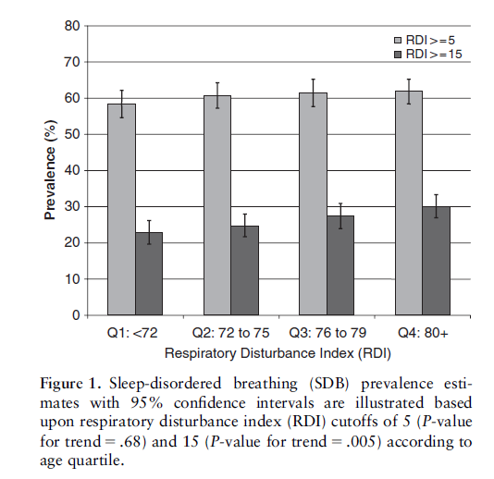
Prevalence of Sleep Disordered Breathing (SDB) by Age, MrOS Sleep Cohort of Older Men
AHI ≥ 5 prevalence is high; does not further increase with advancing age
AHI ≥ 15 prevalence continues to increase with advancing age
Age
Mehra R et al. JAGS 55:1356–1364, 2007

Slide 13
Changes in Sleep Timing in Different Age Groups
Delayed phase
(teenagers)
Sleepy–Go to bed
Wake up
Standard phase
(younger adults)
Sleepy–Go to bed
Wake up
Sleepy
Go to bed
Wake up
Advanced phase
(elderly)
6PM
9PM
12AM
3AM
6AM
9AM
NOON
Time of Day
Wake up for school: sleep is cut short
Modified from Ancoli-Israel, All I Want is a Good Night’s Sleep, Mosby, 1996

Slide 14
Consequences of Sleep Disorders
Previously, sleep loss was not believed to have any serious, long-term impact on human health
      Emphasis on daytime consequences, quality of life
Sleep disorders previously viewed as a consequence of, rather than contributor to, poor health
      previous studies mostly small, cross-sectional
      few studies used comprehensive measures of sleep
Notes:
Sonia Ancoli-Israel, Ph.D.
GC 2000

Slide 15
Sleep in Older Adults
‘Poor sleep’ has been associated with a variety of age-related outcomes:
    Cardiovascular Disease Depression
    Dementia/cognitive decline Diabetes
    Mortality Falls & Fractures
Most epidemiologic studies based on a single domain e.g. sleep duration
  Different sleep domains and sleep disorders (e.g. sleep disordered breathing, insomnia) can impact health via different mechanisms
Directionality of associations uncertain
  Need for longitudinal data and ultimately, interventions

Slide 16
MrOS and SOF Sleep Studies

Slide 17
Osteoporotic Fractures in Men (MrOS):
PIs: Eric Orwoll (OHSU), Steve Cummings (Coord Ctr)
Multi-center prospective study of risk factors for osteoporosis and osteoporotic fractures
Participants recruited from population-based listings at six US clinical centers
5,995 men aged 65 and older enrolled in 2000-2002
Ancillary study: Outcomes of Sleep Disorders in Older Men funded by NHLBI (MrOS Sleep Study, PI: K. Stone)
Notes:
Sonia Ancoli-Israel, Ph.D.
GC 2000

Slide 18
MrOS Sleep Study
Objective assessment of sleep in ~3000 men aged 67 and older (mean age 76.4 yrs), performed in 2003-5.
  in-home overnight polysomnography (PSG)
  5-day wrist actigraphy
In-clinic examination and interview
Ongoing follow-up (tri-annual questionnaire) for endpoints:
  Falls in previous 4 months
  Centrally adjudicated: fractures, deaths, cardiovascular events
Notes:
Split this into two slides (I already did it for you…

Slide 19
Study of Osteoporotic Fractures (SOF)
PI: Steve Cummings (CPMC/UCSF)
Large prospective study coordinated by the San Francisco Coordinating Center
Participants recruited from population-based listings at four US clinical centers
10,366 women aged 65 and older
  9,704 Caucasian women recruited in 1986-88
  662 African American women recruited in 1997-98
Notes:
Sonia Ancoli-Israel, Ph.D.
GC 2000

Slide 20
SOF Visit 8 (2002-3)
Specific aims related to consequences of sleep disturbance in older women, including:
  Risk of falls and fractures
  Risk of total and cause-specific mortality
  Cognitive and physical function
In-clinic examination and interview
Objective assessment of sleep using actigraphy in 3,034 women aged 70 and older (mean age 84 yrs)
  PSG in a subset of 466 women (2 clinic sites)

Slide 21
Overview of SOF and MrOS Sleep Studies
SOF MrOS
Gender Female Male
Age mostly 80+ 67+
#Actigraphy ~3000 ~3000
#PSG ~460 ~3000
Notes:
Add reference to second bullet (we have shown…..)

Slide 22

Primary Sleep Measures: Actigraphy
  watch-like device worn on non-dominant wrist (somewhat like a research-grade FITBIT)
  Contains piezoelectric sensor to detect movements
  Algorithms applied to determine sleep-wake patterns over several days
Notes:
I re-did this one a bit

Slide 23
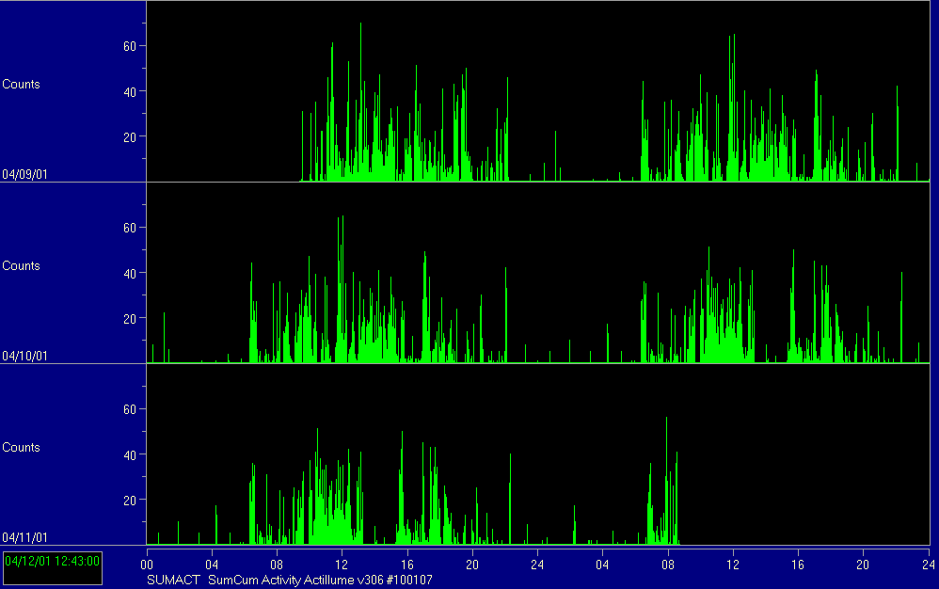
Actigraphy Study: 78-year-old Woman

Slide 24
Key Exposures from Actigraphy
‘Traditional’ night-time sleep-wake variables (averaged over all nights of recording):
  Total sleep time (min)
  Wake after sleep onset (min)
  Sleep efficiency (%)
  Sleep latency (min)
Daytime Napping behavior
Rest-activity rhythms (24 hour patterns):
  Extended cosine model
  Non-parametric methods

Slide 25
Primary Sleep Measures:
In-home single night polysomnography
(Reading Center: BWH Susan Redline)
  13 channels of data collection
  Stages of sleep and wake are determined by EEG, EMG and EOG recordings
  Sleep-related breathing disorders determined based on airflow and oximetry channels
  Periodic limb movements during sleep using leg sensor
Notes:
I re-did this one a bit

Slide 26
Polysomnography:
Compumedics Safiro
Small & Lightweight – 300 grams (9.6 ounces) w/battery
Variable montage - Record up to 32 channels – 144 MB flashcard storage
True digital filtering during collection and review
Remote monitoring all channels with desktop/notebook computer via Radio LAN
Battery Power

Slide 27
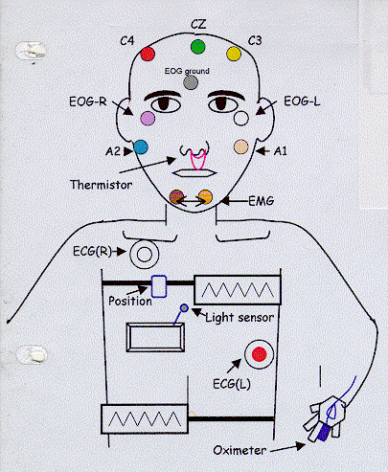
Montage
Illustrated by Kris Sodatani

Slide 28
Polysomnography Variables
  Apnea Hypopnea Index (AHI)
    Number of apneas + hypopneas per hour of sleep
    Apnea = complete cessation of airflow for 10 secs or longer + 3% (or 4%) O2 desaturation
    Hypopnea = partial cesstion of airflow for 10 secs or longer + 3% (or 4%) O2 desaturation
    Sleep disordered breathing (sleep apnea) typically defined as AHI > 5, > 10, > 15
Notes:
I re-did this one a bit

Slide 29
Polysomnography Variables, continued
  Sleep Staging Variables
      % time in REM sleep, Stages 3&4, etc
  Oxygen saturation / nocturnal hypoxemia
      % time < 90% O2 saturation (or 80%)
      Min O2 saturation
  Sleep-wake variables similar to actigraphy (but only overnight)
  Periodic limb movement index (myoclonus index)
Notes:
I re-did this one a bit

Slide 30
Subjective Sleep Measures
Total Sleep Time (self-report)
Pittsburgh Sleep Quality Index
Epworth Sleepiness Scale
Functional Outcomes of Sleep Questionnaire
Insomnia Severity Index
Fatigue

Slide 31
Selected Findings:
Mortality
Falls and Fractures
Cognitive outcomes

Slide 32
Sleep Duration and Mortality
Several studies have reported an association between self-reported sleep duration and mortality
Increased risk among those who:
  Get too much sleep (e.g. 8+ hours per night)
  Get too little sleep (less clear)
  Take naps during the day
Few studies have used comprehensive measures of sleep, including objective and subjective
Notes:
Sonia Ancoli-Israel, Ph.D.
GC 2000

Slide 33
Self-Reported 24-hour Sleep Duration and
Risk of Mortality in Older Women
Stone et al. J Am Geriatr Soc, 2009

Slide 34
Actigraphic Sleep Duration and Risk of Mortality in Older Men and Women
 | All-Cause | Cardiovascular
SOF women
Number of deaths | 997 | 343
Actigraphy TST
<=5 hrs | 1.80 (1.45, 2.23) | 2.30 (1.61, 3.28)
>5 to <=7 hrs | 1.02 (0.88, 1.19) | 1.20 (0.92, 1.57)
>7 to <= 8 hrs | 1.00 (referent) | 1.00 (referent)
>8 hrs | 1.33 (1.10, 1.6) | 1.43 (1.02, 2)
MrOS men
Number of deaths | 711 | 198
Actigraphy TST
<=5 hrs | 1.49 (1.16, 1.9) | 1.15 (0.73, 1.82)
>5 to <=7 hrs | 1.14 (0.94, 1.37) | 0.88 (0.63, 1.23)
>7 to <= 8 hrs | 1.00 (referent) | 1.00 (referent)
>8 hrs | 1.08 (0.80, 1.47) | 0.85 (0.48, 1.51)

Slide 35
Nocturnal Hypoxemia and Risk of Mortality in Older Men
(SaO₂ < 80% > 1% vs ≤ 1% of TST)
 | No. of Events | RH (95% CI)*
All Deaths | 628 | 1.54 (1.09 – 2.16)
Cardiovascular deaths | 217 | 1.53 (0.88 – 2.68)
Cancer deaths | 171 | 2.30 (1.35 – 3.92)
Other (non-cancer, non-CVD) | 240 | 0.81 (0.37 – 1.28)
*Adjusted for age, clinic site, race, BMI, depression, cognition, alcohol use, education, smoking, caffeine, physical activity, chronic disease, medications
Smagula, Stone et al. Psychosom Med 2016; 78(6): 686 – 96)

Slide 36
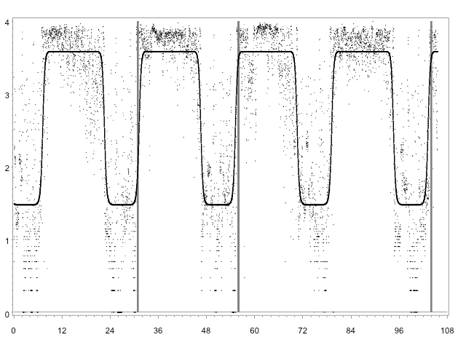
Activity Rhythms and Survival
Strong
Weak

Slide 37
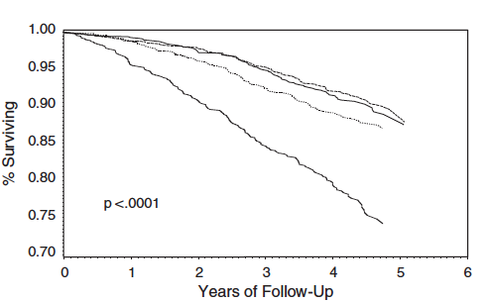
Activity Rhythms and Survival
Strong
Strong
Weak
Weak
Tranah et al, 2010, J Am Geriatr Soc

Slide 38
Shifted rhythms
Late
9:05AM
1:40AM
Mean
7:11AM
11:18PM
Early
5:55AM
10:07PM
1:30PM
2:40PM
3:50PM
Time of Day Peak

Slide 39
5 year mortality
Stroke
2.6 (1.1-6.3)
1.0
2.3 (0.95-5.4)
Cancer
2.1 (1.1-4.2)
1.0
1.0 (0.42-2.6)
Late
Mean
Early
1:30PM
3:50PM
Tranah et al, 2010, J Am Geriatr Soc

Slide 40
Selected Sleep Health Predictors
SLEEP HEALTH
DOMAINS
REPRESENTATIVE SLEEP HEALTH CHARACTERISTICS
DURATION
Actigraphy Mean Total Sleep Time
TIMING
Actigraphy Mean Sleep Midpoint
CONTINUITY
Actigraphy Mean Wake After Sleep Onset
QUALITY
PSQI Sleep Quality Item
SLEEPINESS
Epworth Sleepiness Scale (ESS)
RHYTHMICITY
Pseudo-F (Fit of Cosine to Actigraphy )
REGULARITY
Actigraphy St. Dev. Wake Time
Created categorical versions to indicate extreme sleep characteristics
Computed number of extreme characteristics
Random Survival Forest analysis
Notes:
We selected one representative sleep health characteristic for each of the proposed sleep health domains. When making selections, we prioritized objective measures, stability, and clinical relevance. For duration we selected actigraphy total sleep time. For timing we selected actigraphy sleep midpoint. For continuity we selected actigraphy wake after sleep onset. For quality we selected the PSQI sleep quality item, for rhythmicity we selected the pseudo-F statistic, which indicates the goodness of fit of an extended cosine model to the raw actigraphy data, and for regularity we selected the actigraphy standard deviation of wake time. These are all relatively independent of one another, with a maximum magnitude correlation of about 0.2. Finally, to enhance clinical relevance, we also created categorical versions of these characteristics, indicating extreme values. These cut-points were based on clinical guidance where available. In the absence of clinical relevance we selected cut-points based on tertiles of the distributions.

Slide 41
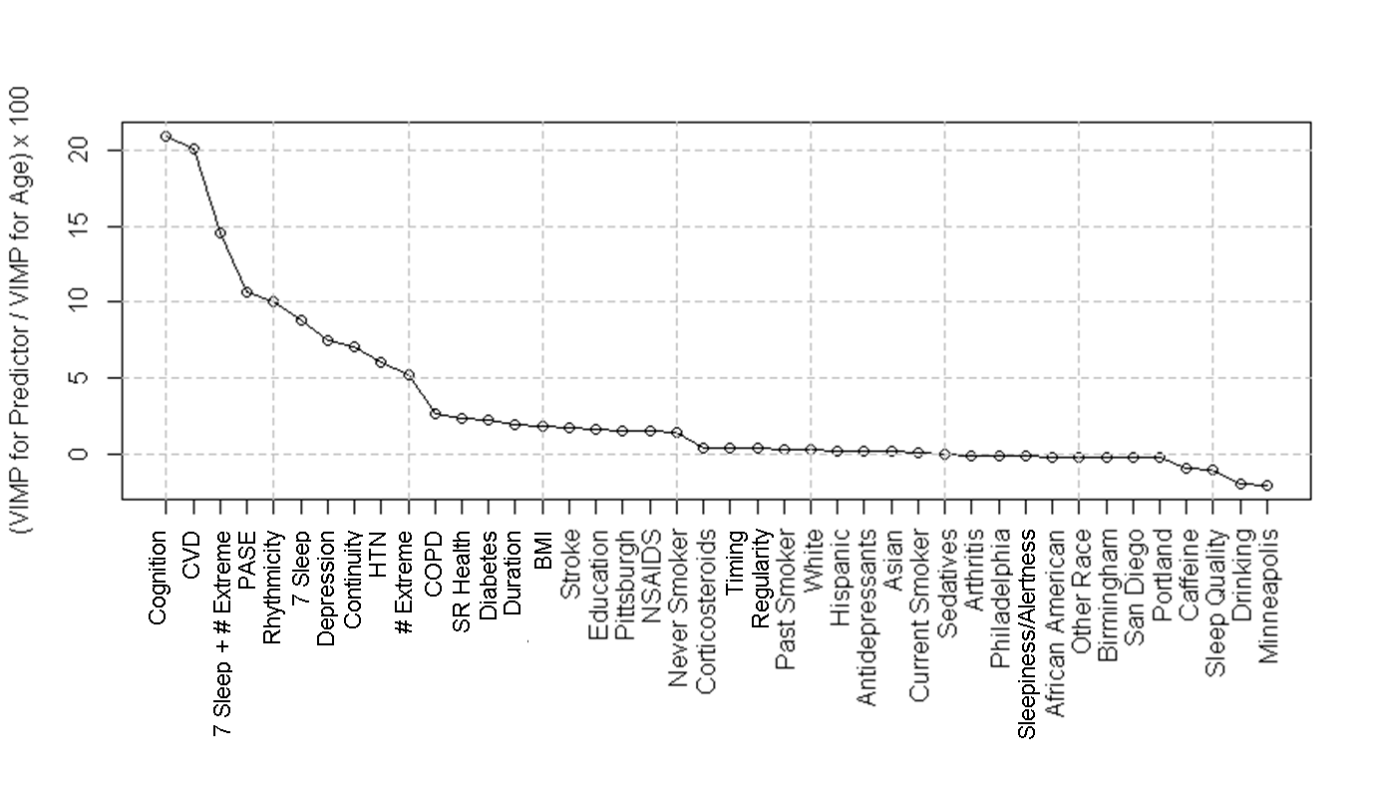
Which Sleep Health Characteristics Predict Mortality in Older Men?
All sleep information considered jointly
Rhythmicity
VIMP or Predictor Relative to VIMP of Age X 100
Continuity
# Extreme Characteristics
Duration
Timing
Sleepiness
Quality
Regularity
Notes:
Here are the VIMP results from the random forest. On the Y axis is the importance of the predictor relative to the importance of age, expressed as a percentage. The two predictors with the largest age-relative vimps are cognition and cvd. They have variable importances that are about 20% of the importance of age. And next comes all the sleep health information considered jointly, at about 15% as important as age. Following this are rhythmicity at about 10%, continuity at about 8%, the number of extreme characteristics at about 5 %, duration at about 3%, and everything else around 0%, which indicates that they are essentially no more predictive then random noise.

Slide 42
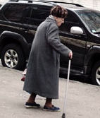
Characteristics of Sleep and Risk of
Falls and Fractures

Slide 43
Sleep and Falls
Falls occur in approximately a third of community-dwelling older adults each year
  >50% of institutionalized elders fall each year
  Major cause of disability and mortality
Evidence suggests increased fall risk in older adults with sleep problems
  ‘Poor sleep’ may represent a potentially modifiable risk factor to reduce risk of falls

Slide 44
Sleep and Falls, continued
Controversy: is it the sleep problem, or medications (e.g. hypnotics) used to treat the sleep problem that is responsible for increased fall risk?
  Most studies did not examine the independent effects of disturbed sleep and medications used to treat sleep
Clinical trials assessing pharmaceutical interventions for insomnia have not been designed with power to test effects of treatment on risk for falls

Slide 45
Actigraphic measures of nightly sleep duration and risk of falls in older women¹ (SOF)
n=2,978, mean age=83y
Reference
1. Stone KL et al. Arch Int Med 2008; 168(16): 1768-75.
* Falls were ascertained by tri-annual questionnaire. 549 women (18.4%) suffered 2+ falls during approximately one year after sleep assessment. Results adjusted for age, race, BMI, depression, exercise, instrumental activities of daily living, comorbidities, cognitive function, and use of benzodiazepines and antidepressants.

Slide 46
Actigraphic measures of sleep and risk of falls in older women¹ (SOF), additional results
Results between sleep duration and fragmentation and risk of falls were unchanged by adjustment for benzodiazepine use
Use of short-acting benzodiazepines was associated with increased risk of frequent falls, even after accounting for objectively measured sleep
  OR=1.53, 95% CI=1.00–2.32
1. Stone KL et al. Arch Int Med 2008; 168(16): 1768-75.

Slide 47
Non-benzodiazepine sedative hypnotics and risk of falls & fractures
Newer ‘Z’ drugs believed to be safer because of shorter half life
Few studies (no trials) of these drugs and risk of falls and fractures…. However so far it is not looking good!
Zolpidem is a commonly prescribed insomnia medication in the elderly

Slide 48
Use of non-benzodiazepine hypnotics and risk of falls in older men
Clinic Visit during 2007-2009
Among 4450 older men:
  97 reported using non-benzodiazepine hypnotics
    84 zolpidem
    3 zaleplon
    10 eszopiclone
Incident falls in the subsequent year after the clinic visit were ascertained by self-report
  Any falls (at least 1 fall during the subsequent year)
  Recurrent falls (2 or more falls during the subsequent year)
Diem et al, 2014, J Gerontol Geriatr Res.

Slide 49
Use of non-benzodiazepine hypnotics and risk of falls in older men*
*Adjusted for age, site, GDS score, educational status, BMI, comorbidity index, ability to stand from a chair, PASE score, self-reported health status, IADL impairments, alcohol use, and MMSE
Diem et al, 2014, J. Gerontol Geriatr Res.

Slide 50
Later Acrophase Associated with Increased
Recurrent Fall Risk in Older Men
(≥ 2 falls vs < 2 falls in the subsequent year)
 | No. of Events | OR (95% CI)*
Early (< 1pm) | 52 | 0.86 (0.62, 1.20)
Normal (reference) | 282 | 1.0
Late (> 3:30pm) | 83 | 1.46 (1.08, 1.97)
*Multivariate adjusted model
Rogers et al. Osteoporos Int 2017; 28: 1313-1322

Slide 51
Nocturnal Hypoxemia and Risk of Falls and Fractures in Older Men
% TST with SaO2 < 90% | # Recurrent Falls | OR (95% CI)* | #Non-spine FX | RH (95% CI)*
< 1% (ref) | 166 | 1.0 | 167 | 1.0
1 to 3.4% | 101 | 1.04 (0.82 – 1.33) | 97 | 1.24 (0.94 – 1.64)
3.5 to 9.9% | 58 | 1.16 (0.86 – 1.57) | 49 | 1.41 (1.00 – 2.00)
≥ 10% | 71 | 1.43 (1.06 – 1.92) | 49 | 1.31 (0.88 – 1.95)
 |  | P (trend) < .05 |  | P (trend) < .05
*Multivariate adjusted model
Cauley et al. J Am Geriatr Soc 2014; 62(10): 1853-9.

Slide 52
Sleep Disturbance and Cognitive Function in the Elderly
Association is likely bi-directional, however most studies are cross-sectional
Most studies ascertained sleep by self-report, which may be inaccurate in populations with some cognitive impairment
Mechanisms? Sleep ➔ Cognition/decline
  Inflammation
  Metabolic
  Sleep plays a role in clearing proteins (e.g. amyloid) from the brain

Slide 53
Association Between Actigraphic Sleep Parameters and Cognitive Impairment in Older Women
3
1.96
1.74
1.61
1.42
2
Odds Ratio
1.24
1.23
1.13
1.15
0.98
0.97
1
0
Trails B>278 sec
MMSE<26
Blackwell et al, 2006, J. Gerontology
Notes:
I re-did this one a bit

Slide 54
Sleep Disordered Breathing and Cognitive Aging
Sleep disordered breathing may impact cognitive outcomes due to:
  Exposure to low levels of oxygen throughout the night (nocturnal hypoxemia)
  Insufficient or more fragmented sleep in general (due to arousals)
Notes:
Do you really know if they were out of bed? I would just say hours of sleep scored during the day; or scored between the final awakening time and the time to bed.
All variables reflect average daily experience - does this = the mean of days worn?

Slide 55
Study of Osteoporotic Fractures (SOF)
Sleep and Cognition Ancillary Study
Sleep/
circadian
MCI/Dementia
Follow-up
Baseline
1986-88
(N=9,704)
(65+ yrs.)
2002-04
(N=3,127)
(70-99 yrs.)
2006-08
(N=950)
(72-102 yrs.)

Slide 56
SOF Dementia & MCI Adjudication (N=950)
MCI/dementia visit data used:
Cognitive testing: 3MS, CVLT, Trails B, Digit Span, Category & Verbal Fluency
Functional status & assessment questionnaires (i.e., ADL/IADL, IQCODE)
Medications (e.g., Medication Inventory Form, Supplemental MIF, Medication Use Form)
Mood status (i.e., Geriatric Depression Scale)
Medical History / Comorbidities (i.e., Medical History Form)
Demographic information: Age, race, and education level
Sleep Baseline Data used:
Cognitive testing: MMSE, Trails B
Notes:
Do you really know if they were out of bed? I would just say hours of sleep scored during the day; or scored between the final awakening time and the time to bed.
All variables reflect average daily experience - does this = the mean of days worn?

Slide 57
Sleep Disordered Breathing & MCI/Dementia in Older Women
Prevalent sleep disordered breathing: 35.2% (n=105)
At follow up, MCI/Dementia: 35.9% (n= 107)
 | MCI/dementia N (%) | Unadjusted OR (95% CI)
No SDB | 60 (31.1) | -
SDB (AHI ≥ 15) | 47(44.8) | 1.80 (1.10, 2.93)
Yaffe et al. JAMA 2011; 306(6): 613-19.

Slide 58
Sleep Disordered Breathing &
MCI/Dementia in Older Women
5
4
3
Odds Ratio
2
1
0
Adjusted*
OR =1.95
(1.16 – 3.26)
Unadjusted
OR =1.80
(1.10, 2.93)
Adjusted + Cog**
OR=2.33
(1.28 – 4.25)
*Adjusted for age, body mass index, educational attainment, history of diabetes and MI
**Adjusted for above variables + baseline cognitive test scores
Yaffe et al. JAMA 2011; 306(6): 613-19.

Slide 59
5 year Dementia or MCI
Dementia - MCI
1.8 (1.2 - 2.6)
1.0
1.2 (0.80 – 1.8)
Late
Mean
Early
1:30PM
3:50PM
Tranah et al. 2011, Annals of Neurology

Slide 60
Acrophase – 5 year Cognitive Impairment
MCI (n=243) Dementia (n=147)
1.7 (1.1 - 2.7) 2.0 (1.1 - 3.5)
1.0 1.0
1.3 (0.82 - 2.0) 0.98 (0.53 - 1.8)
Late
Standard
Early
1:30PM
3:50PM
Adjusted for age, clinic site, race, BMI, cognitive function, walking for exercise, IADL impairments, depression, current use of benzodiazepines or antidepressants, alcohol use, smoking status, total sleep time, self-reported health status, and comorbidities.
Tranah et al. 2011, Annals of Neurology

Slide 61
Selected Additional Findings
(of 95 publications to date)
Actigraphic Sleep Duration and Fragmentation in Older Women: Associations with Performance Across Cognitive Domains. Spira et al. Sleep. 2017 (in press)
Determinants of Change in Objectively Assessed Sleep Duration Among Older Men. Smagula et al. Am J Epidemiol. 2017;185(10):933-940.
An Aggregate Measure of Sleep Health Is Associated With Prevalent and Incident Clinically Significant Depression Symptoms Among Community-Dwelling Older Women. Furihata et al. Sleep. 2017;40(3).
Sleep Disturbances and Risk of Hospitalization and Inpatient Days Among Older Women. Paudel et al. Sleep. 2017;40(4).
Who Take Naps? Self-Reported and Objectively Measured Napping in Very Old Women. Leng et al. J Gerontol A Biol Sci Med Sci. 2017 (in press)
Associations of Incident Cardiovascular Events With Restless Legs Syndrome and Periodic Leg Movements of Sleep in Older Men. Winkelman et al. Sleep. 2017;40(4).
Daily Patterns of Accelerometer Activity Predict Changes in Sleep, Cognition, and Mortality in Older Men. Zeitzer et al. J Gerontol A Biol Sci Med Sci. 2017 (in press)
Longitudinal relationships of periodic limb movements during sleep and incident atrial fibrillation. May et al. Sleep Med. 2016;25:78-86.
Sleep Disordered Breathing and Risk of Stroke in Older Community-Dwelling Men. Stone et al. Sleep 2016;39(3):531-40.

Slide 62
SOF and MrOS Sleep for Trainees
Successful K awards:
  A. Spira, Johns Hopkins: Sleep and Functional Decline
  M. Rao, UCSF: Sleep and Endocrine Function
  C. Swanson, U Colorado: Sleep duration and bone outcomes
  Y. Leng, UCSF: Napping and cognitive decilne
  J. Li, U Penn: Activity patterns and cognitive decline
VA Career Development award:
  E. Klingaman, Baltimore VA: Interactions of Depression and Insomnia
Early Stage Investigator awards:
  G. Tranah, Circadian genes and aging outcomes
  R. Mehra, Case Western: SDB and arrhythmias
  M. Wallace, U Pittsburgh: Sleep health and mortality

Slide 63
The Future:
SOF, MrOS and Beyond

Slide 64
Future Directions (SOF and MrOS)
“Sleep Health” – multiple, interacting domains of sleep
  Subjective sleep health and incident disability, healthcare utilization (Stone, Buysse, Ancoli-Israel) - Merck ISP, funded
  Sleep Health and Mortality: Machine Learning approaches (Meredith Wallace, U. Pittsburgh) – NHLBI ancillary R01, funded
Novel approaches for analyzing 24-hour activity patterns, risk of MCI/dementia (Stone, Zeitzer, Tranah) – planned R01 submission, August 2017
OMICS:
  Metabolomics of sleep, CVD and cognition: pooled study with MrOS and Women’s Health Initiative. (submission fall 2017)
  Gut microbiome and sleep in MrOS (August 2017)
Sleep/rest-activity rhythms and Cancer
  Linkages with state cancer registries (Feb 2018)

Slide 65
Sleep in Hospitalized Older Adults
Overarching hypothesis: poor sleep in the hospital setting is common, and impacts recovery, readmissions, risk of delirium, and other key outcomes
Sutter Tracy Community Hospital Sleep Study
  Actigraphy (wearable device) to assess sleep in a pilot sample of 100+ hospitalized older adults
  Pilot study funded by Sutter Tracy Hospital Foundation
Future plans:
  Evaluate sleep as a potential target for interventions to prevent delirium and other key outcomes (larger observational studies, randomized trials)

Slide 66
Sleep in Chronic Pain
Rheumatoid Arthritis: collaboration with UCSF (Patti Katz) to explore bi-directional relationships of objectively measured sleep and pain/RA symptoms (pending funding, NIAMS)
Osteoarthritis: collaboration with UCSF (Michael Nevitt) to examine role and mechanisms of sleep in pain, pain sensitivity, OA outcomes (planned submission August 2017)

Slide 67
Intervention Studies
Safer interventions for sleep in older adults
  Hypnotics have risks especially in elderly
  Can interventions to improve sleep prevent outcomes like falls, slow cognitive decline?
  Cognitive behavioral therapy for insomnia, exercise, CER vs hypnotic use
PCORI hosted public discussion on CER for insomnia, identified as huge gap

Slide 68
Acknowledgements
Special thanks to:
  Susan Redline, Brigham and Women’s Hospital
  Sonia Ancoli-Israel, Univ of California, San Diego
  Terri Blackwell, CPMC Research Institute
Funding sources (SOF, MrOS):
  NIH/NHLBI (MrOS Sleep Study)
  NIH/NIA (SOF Sleep and Cognition Study, SOF, MrOS)
  NIH/NIAMS (funded the SOF and MrOS parent study cohorts)
SOF and MrOS participants

